Slide 1
TCP on Tokamak Programmes (CTP TCP)
Luo Delong
Thursday 16 February 2023, IEA FUSION POWER CO-ORDINATING COMMITTEE (FPCC)

Slide 2
Outline
Membership
Implementing Agreement Modernisation
Election of the New Chair
Meetings
Highlights

Slide 3
Membership
CTP TCP has 8 Contracting Parties (CPs)
4 IEA member countries:
Australian Nuclear Science and Technology Organisation (ANSTO), Australia
National Institutes for Quantum and Radiological Science and Technology (QST), Japan
Korean Ministry of Education, Science and Technology (MEST), Korea
United States Department of Energy (USDOE), United States
1 partner country:
The Institute for Plasma Research (IPR), India
3 International Organizations:
European Atomic Energy Community (Euratom), European Union
ITER China Domestic Agency (CNDA)
ITER Organization

Slide 4
Membership
The Executive Committee of the CTP TCP unanimously resolved through a written procedure in a decision ending on 31st August 2022 to invite the Government of Switzerland and United Kingdom to join the CTP TCP as a Contracting Party. Respective invitations were sent on 30 September 2022
The Government of Switzerland has accepted the invitation

Slide 5
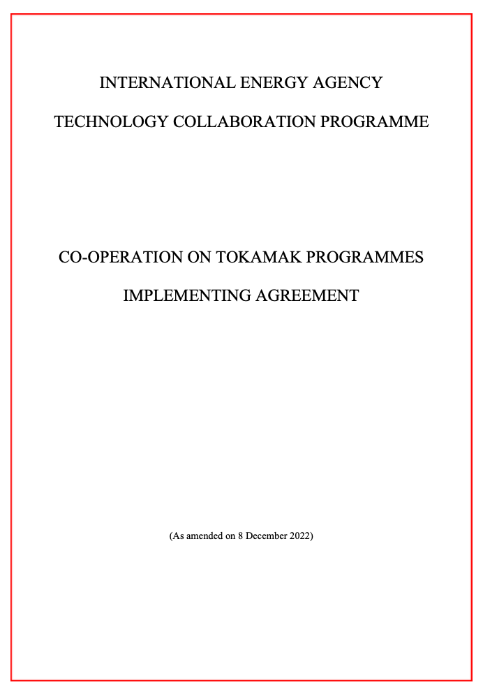
Implementing Agreement Modernisation
The CTP TCP Executive Committee unanimously approved the revised CTP TCP Implementing Agreement prepared by the IEA secretariat and revised by the parties.
The new CTP TCP Implementing Agreement is now in force, as amended on 8 December 2022.

Slide 6
Election of the New Chair
Executive Committee unanimously approved the nomination of Shunsuke Ide (JP) as Chair of the IEA TCP CTP Executive Committee for the period from 1st March 2023 to 28th February 2026

Slide 7
Meetings
12th Executive Committee Meeting at the ITER Organisation Headquarters, St. Paul-lez-Durance, France, Thursday 8th December 2022
25th meeting of the International Tokamak Physics Activity Coordinating Committee (ITPA CC) and 13th ITPA meeting for Joint Experiments at the ITER Organisation Headquarters, St. Paul-lez-Durance, France, 6th-7th December 2022

Slide 8
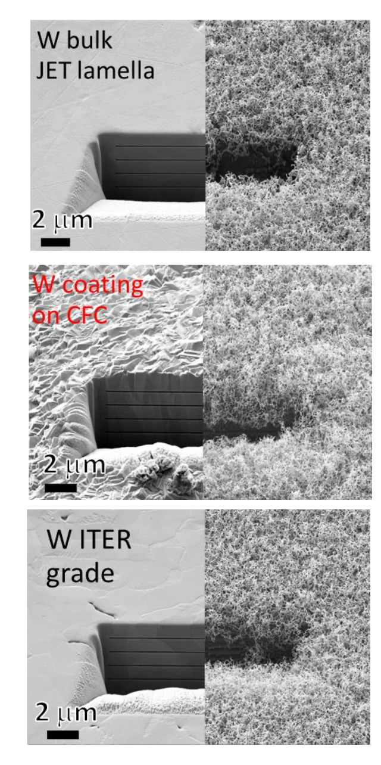
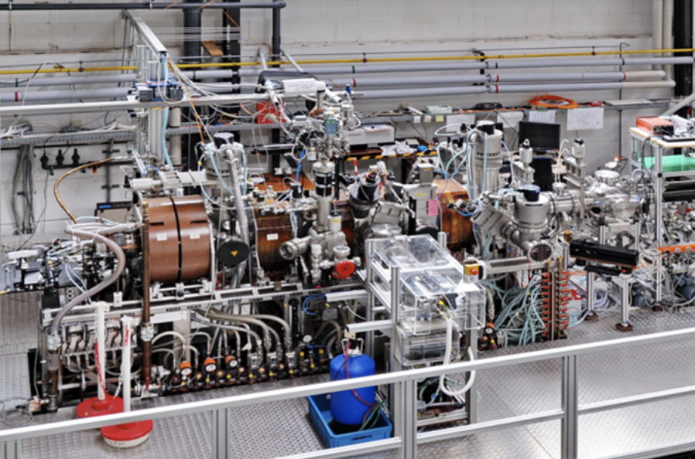
Highlights: DSOL-33: key results from 2022
PSI-2
PSI-2: mimic JET and AUG: Tungsten (W) fuzz formation in Helium independent on type of tungsten
ELMy H-mode in AUG: W fuzz growth, net W erosion and W re-deposition occurs at outer target plate in poloidal direction
ELMy H-mode in JET: No obvious in-situ W fuzz growth observed, despite matching conditions tested in PSI-2.
PSI-2 in Jülich

Slide 9
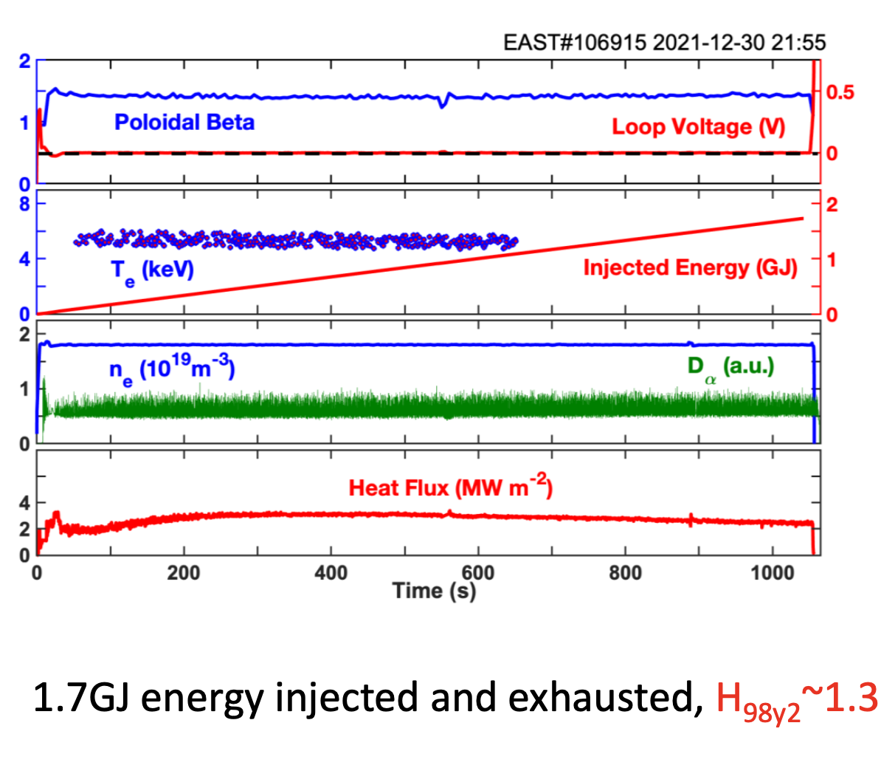
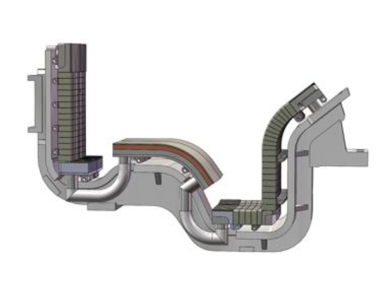
Highlights: Long-pulse plasma operation achieved
-pulse plasma operation achieved
Long-pulse plasma operation achieved with robust plasma control under full metal wall lasting > 1000 seconds at EAST
New lower EAST W-divertor with closed outer and open inner divertors for balanced detachment

Slide 10
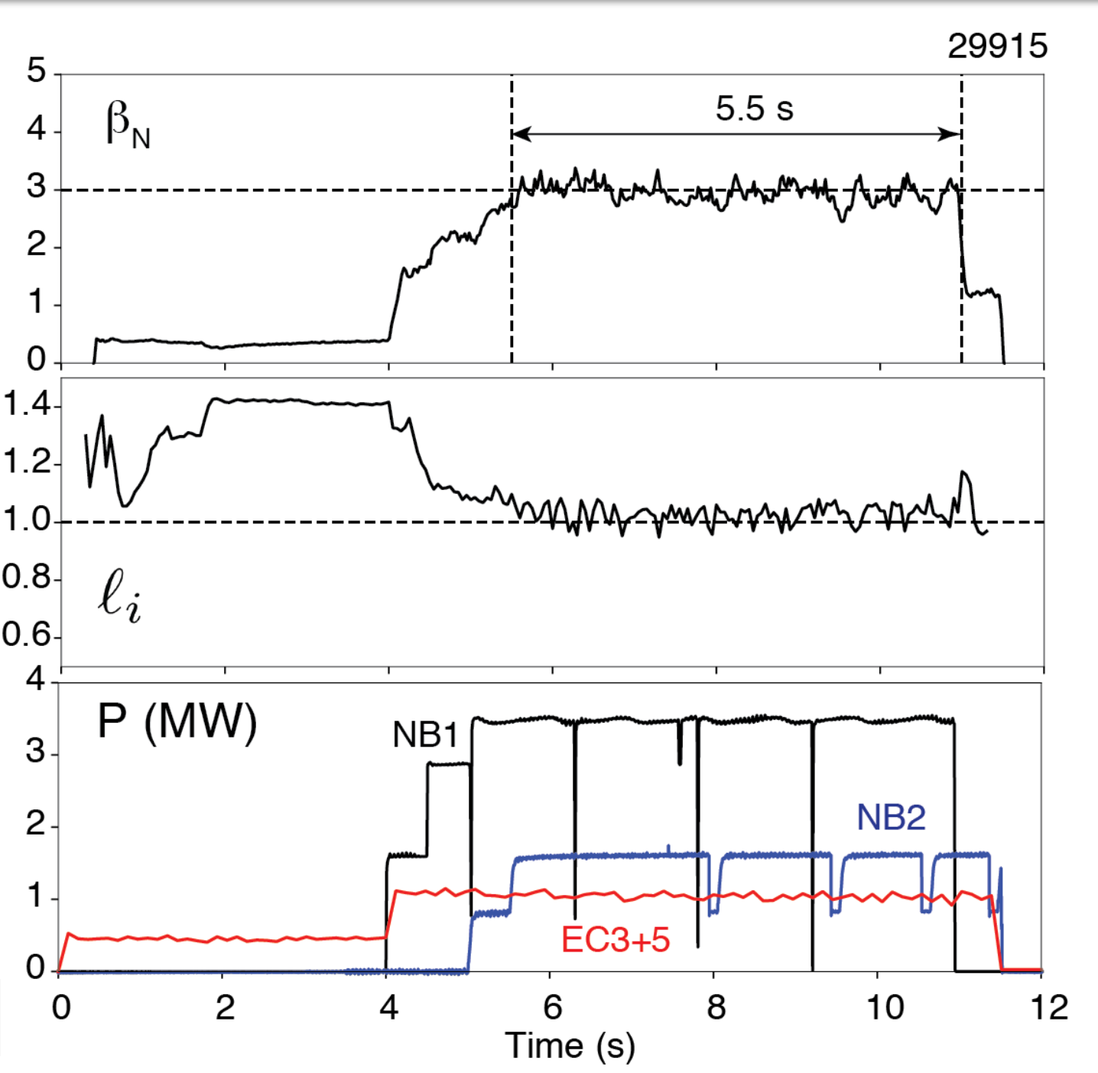
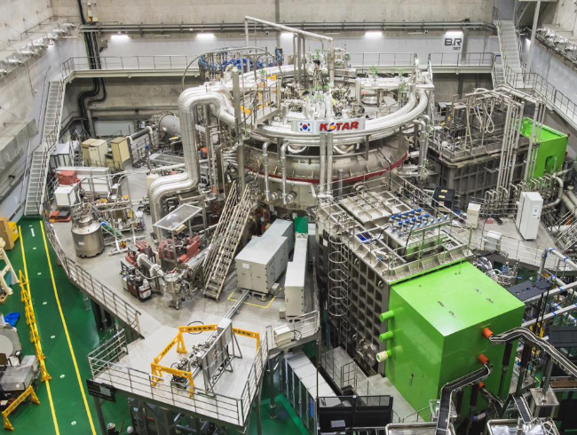
Highlights: Scenario Development
Stationary High Internal Inductance Mode β_{N} = 3 discharge developed at lower magnetic field for Long Pulse Operation in KSTAR

Slide 11
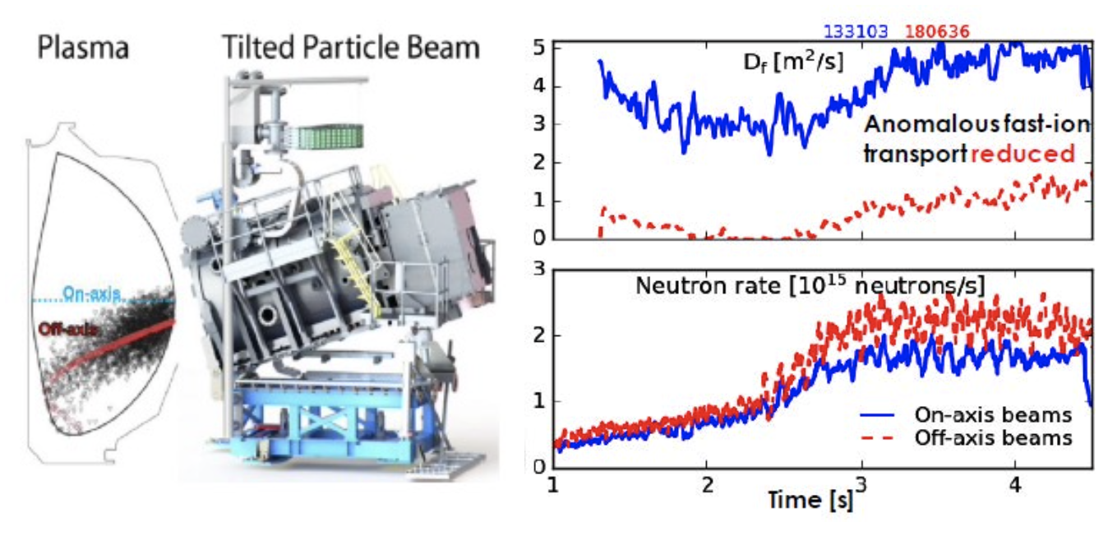
Highlights: Off-axis NBI decreases fast-ion transport
Off-axis NBI broadens current profile, decreases fast-ion transport in DIII-D

Slide 12
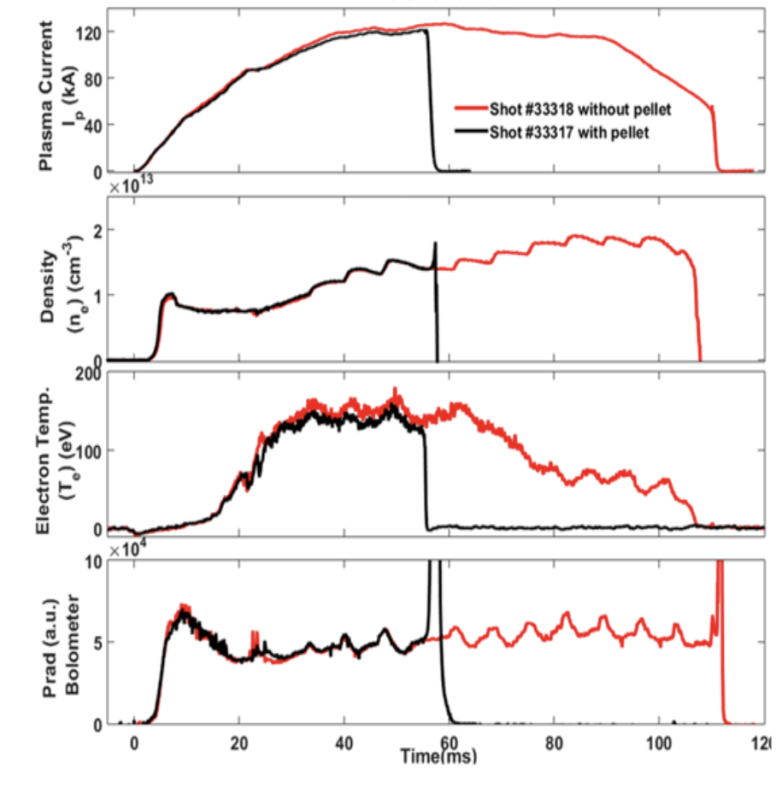
Highlights: Electromagnetic Pellet injector
First time an electromagnetic pellet injector used to fire pellets into a tokamak in ADITYA-U in a significant development ITER disruption control
Particle size (Li titanate) ~ 50 micron
Particle velocity ~ 200 m/s
Particles reached ADITYA-U core in ~ 4 ms
Amount injected ~ 50 – 200 mg

Slide 13
Thank you for your attention

